Slide 2
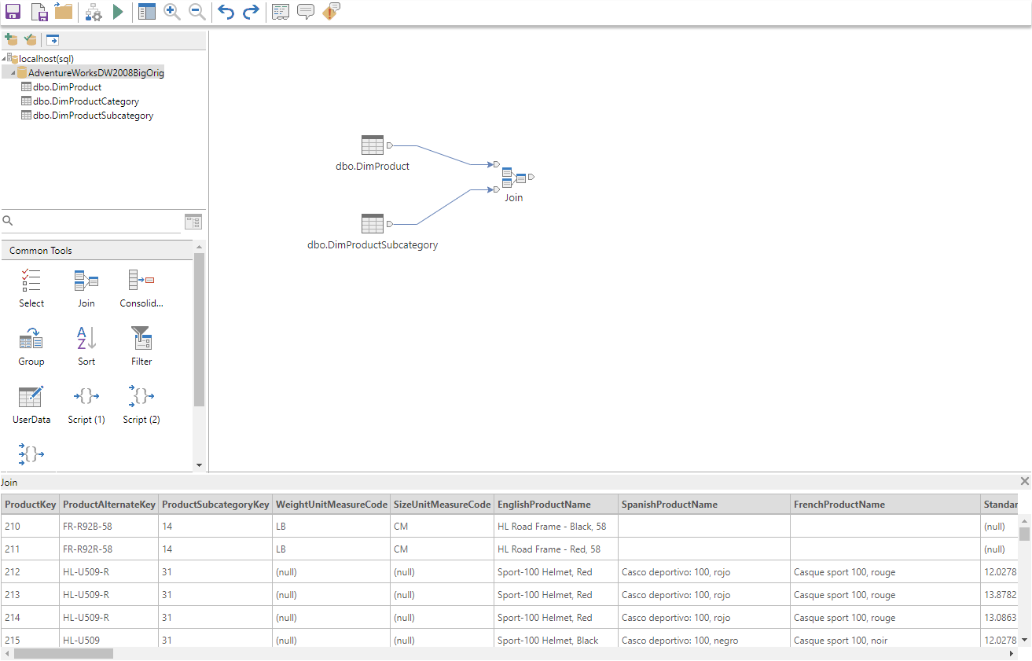
DataFlowDesigner
SourceManager
Canvas
Diagram
Toolbox
Console

Slide 3
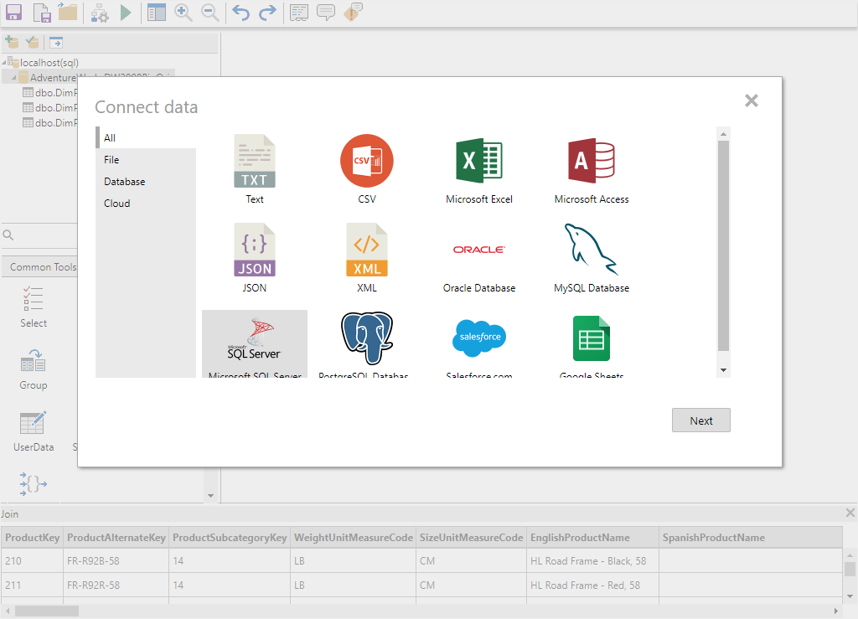
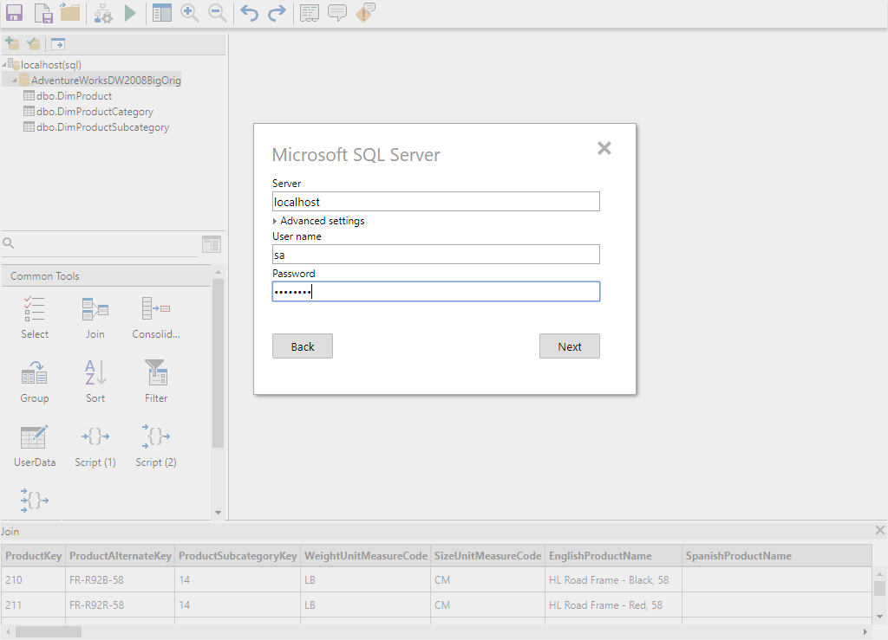
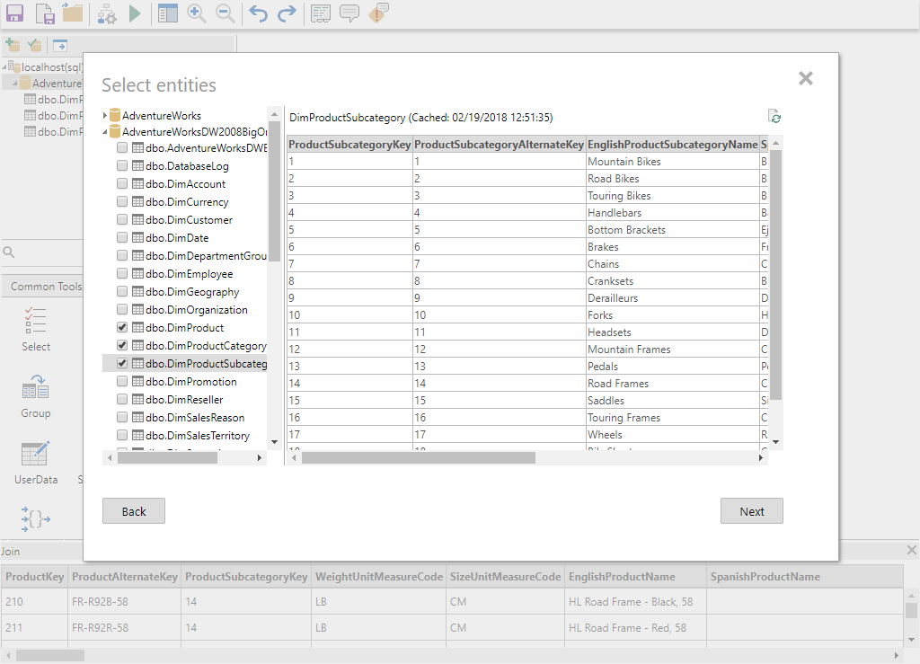
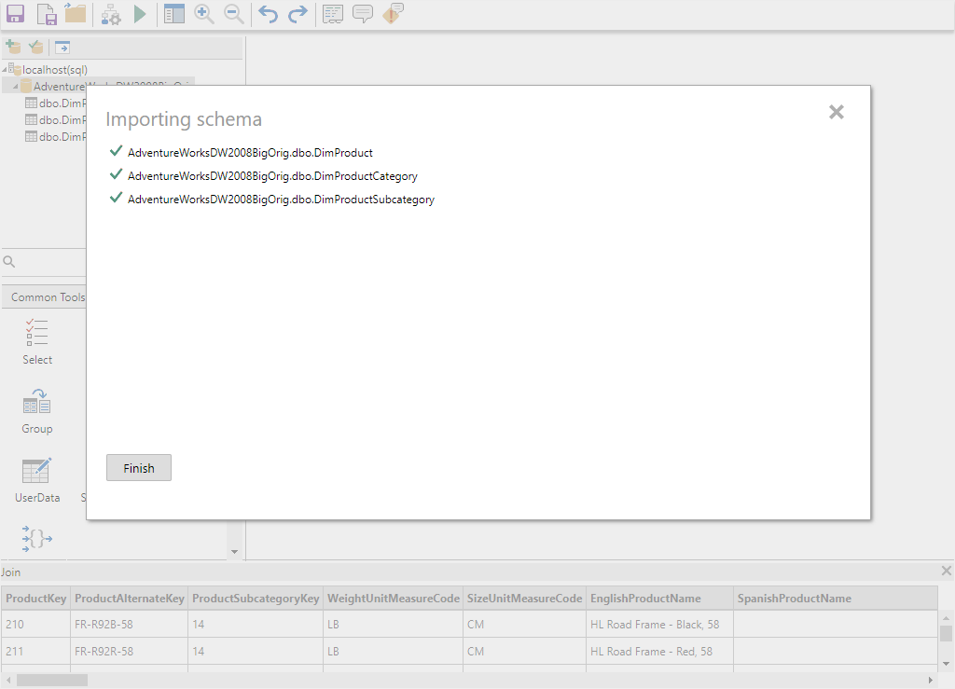
SourceImporter
ConnectionSelector
ConnectorProxy
TableSelector
SchemaLoader

Slide 4
